Slide 1
Headstart 2019
Looking through the eyes of a computer
Colin Paterson

Slide 2

Exercise
http://caffe.berkeleyvision.org

Slide 3
Machine Learning
What’s it all about
We are drowning in information and starving for knowledge
- John Naisbitt
“Machine Learning is the science of getting computers to learn and act like humans do, and improve their learning over time in autonomous fashion, by feeding them data and information in the form of observations and real-world interactions.”
https://emerj.com/ai-glossary-terms/what-is-machine-learning/

Slide 4
Machine Learning
Allows us to find a mathematical description of system/component behaviors from observed data.
The models found allow us :
Find patterns
Predict what will happen in the future
Learn the best action to take

Slide 5
Model fitting

Slide 6
Model fitting

Slide 7
Model fitting

Slide 8
ML : model fitting
Ockham’s razor : Choose the simplest hypothesis (model) consistent with the data.

Slide 9
ML : model fitting with noise
x
x
x
x
x
x
x
x
x
x
x
x
x
x
x
x
x
x

Slide 10
ML: Measuring error (Loss)
x
x

Slide 11
ML : Training a model

Slide 12

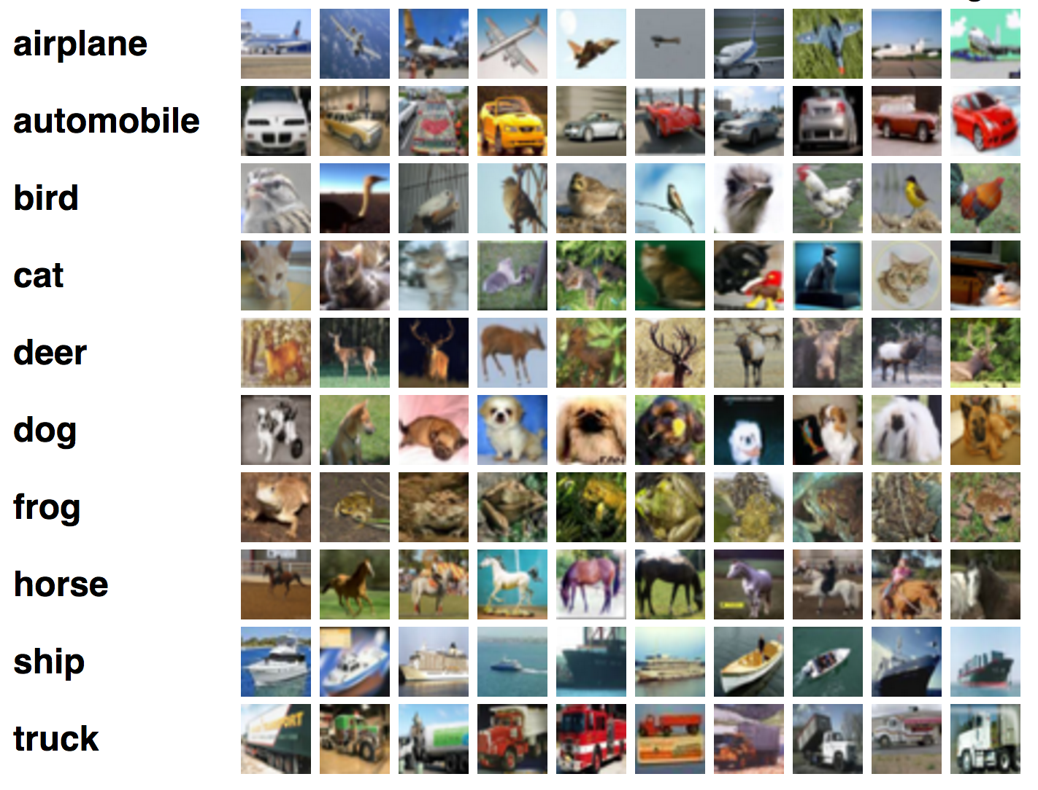
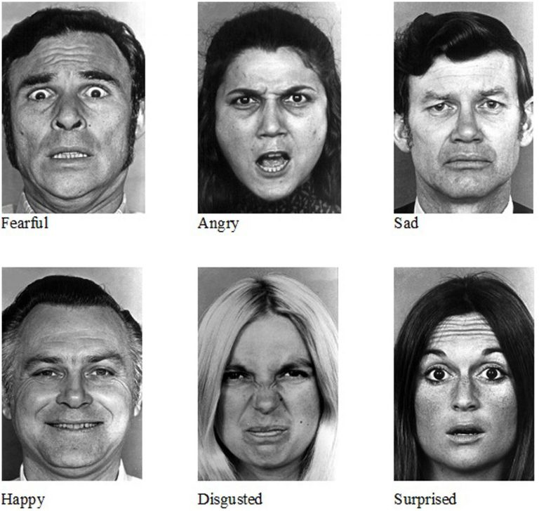
Classification

Slide 13
Classification
Notes:
labelled data.

Slide 14
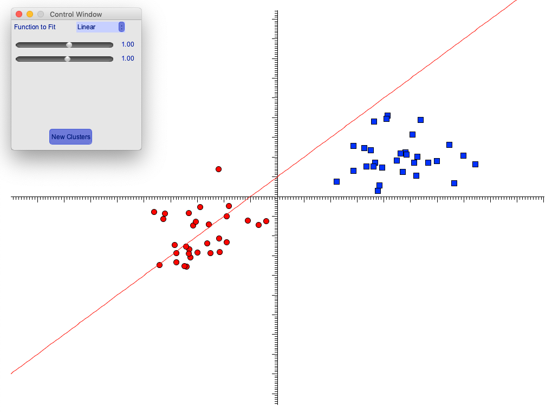
Exercise
Use the application to find a function which could be used to separate the clusters.
Is their a systematic way of doing this?
Notes:
labelled data.

Slide 15
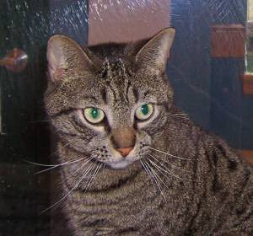
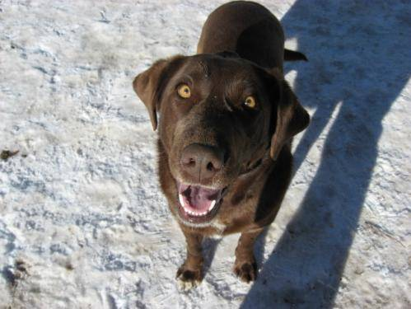
More complex problems

Slide 16
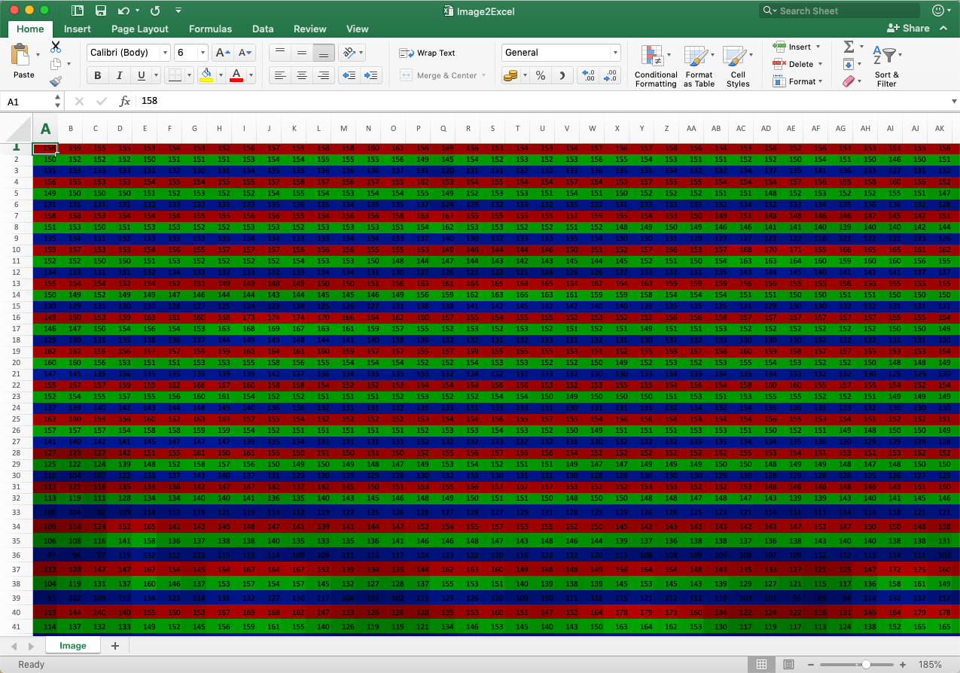
Spreadsheets
http://think-maths.co.uk/spreadsheet

Slide 17
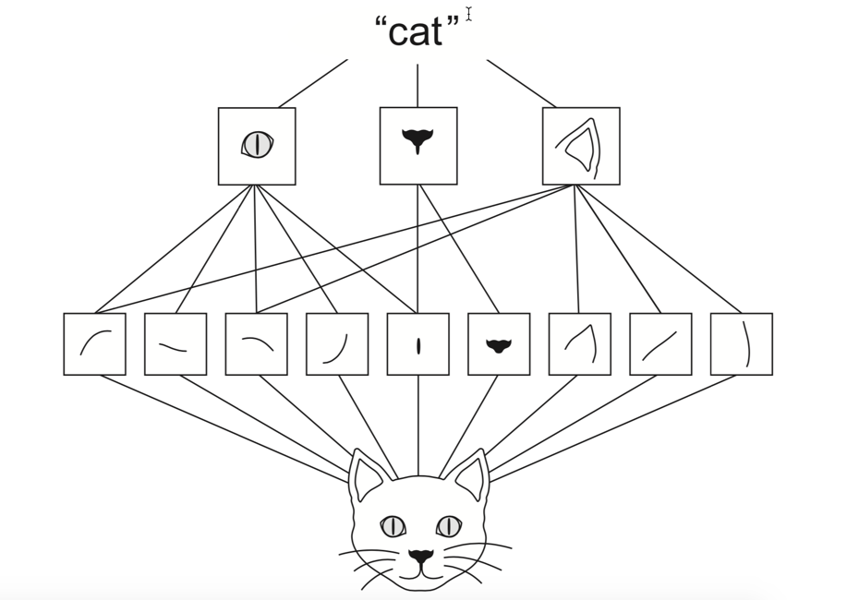
Convolutional Layers
Deep Learning with Python : François Chollet

Slide 18
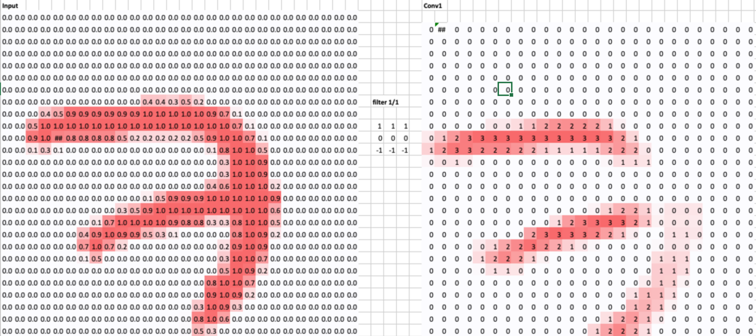
Convolutional Layers
https://towardsdatascience.com/understanding-convolutions-using-excel-886ca0a964b7

Slide 19
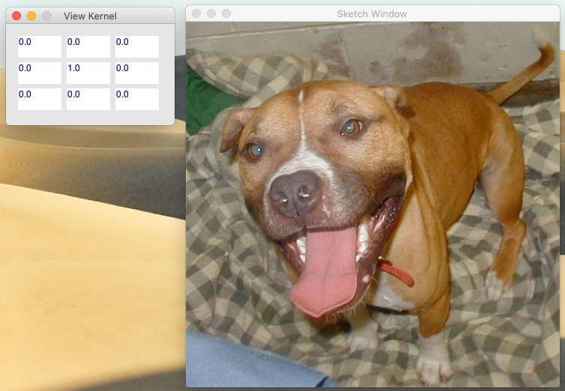
Exercise
Notes:
labelled data.

Slide 20
Neural Networks

Slide 21
Artificial Neuron
x₁
w₁
x*
x₂
w₂
+
f(x*)
w₃
x₃
x* = w₁x₁ + w₂x₂ + w₃x₃

Slide 22
Activation Functions
https://medium.com/@shrutijadon10104776/survey-on-activation-functions-for-deep-learning-9689331ba092

Slide 23
Universal Approximation Theorem
(Neural Networks) can approximate every non-linear real-valued function of n real-valued inputs

Slide 24
XOR Gate Example
Input 1 | Input 2 | Output
0 | 0 | 0
0 | 1 | 1
1 | 0 | 1
1 | 1 | 0
input2
input1

Slide 25
XOR Gate example
Bias node = 1
-10
20
-30
Input 1
20
output
20
-20
20
Input 2
-20
30

Slide 26
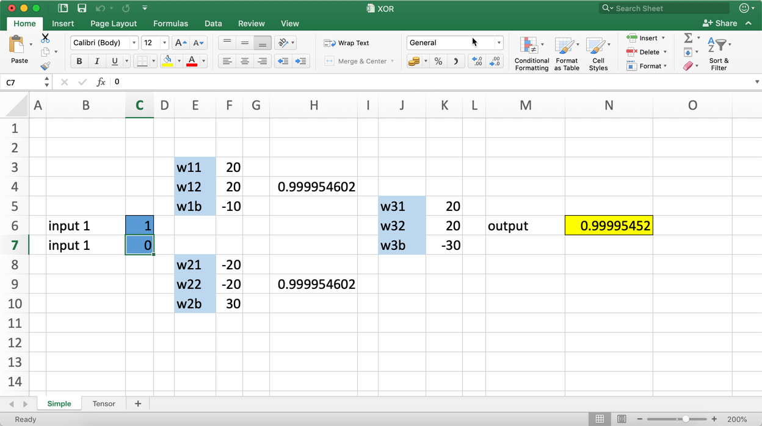
XOR Gate example

Slide 27
Neural Networks
A worked example
If x > 0 then red
Otherwise blue
x1 | x2 | Formula | Output
0 | 0 | 0 + 0 | 0
1 | 0 | 0.86 + 0 | 0.86
0 | -1 | 0 – 1.1 | 0
… | … | … | …

Slide 28
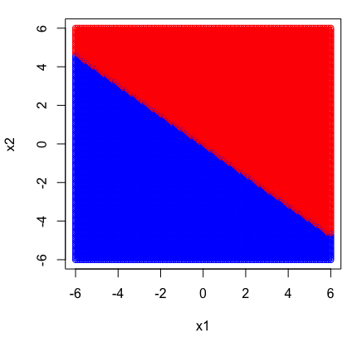
Neural Network
One Neuron

Slide 29
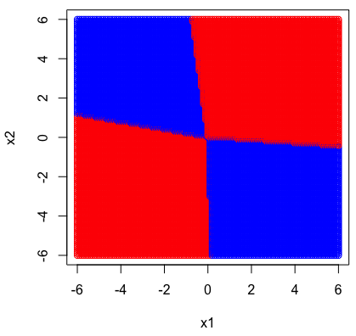
Neural Networks
Hidden Layers

Slide 30
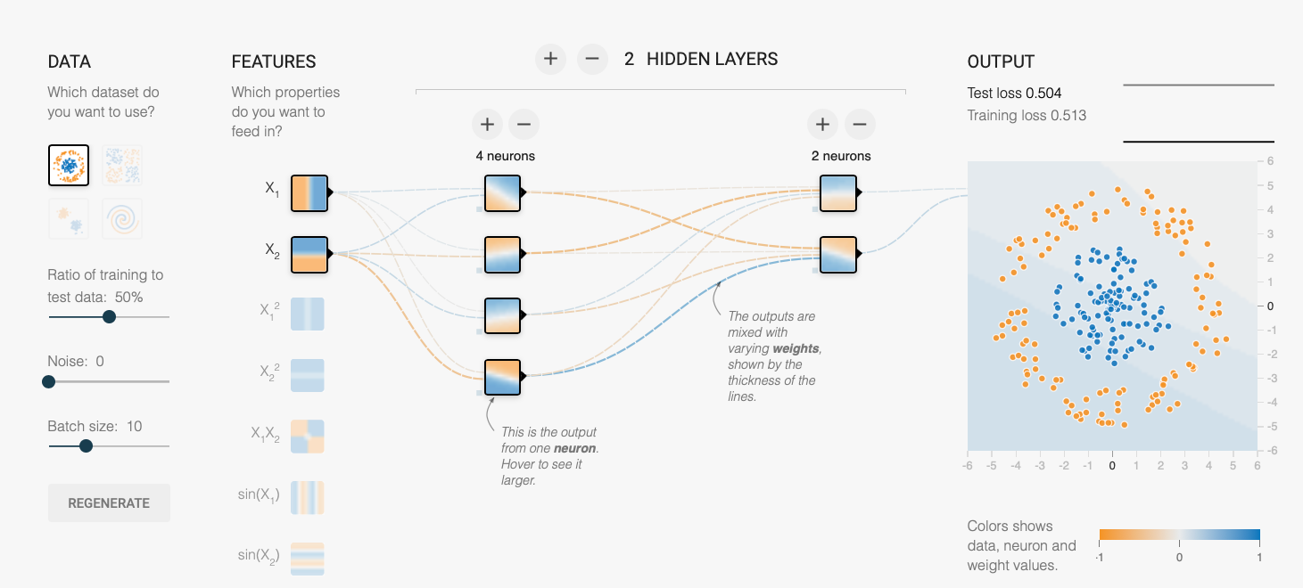
Exercise : Neural Networks
https://playground.tensorflow.org/

Slide 31


Funded by

